Slide 1
Learning Transferable Visual Models From Natural Language Supervision (CLIP) OpenAI 2021
Presented by Changyuan Qiu
February 10, 2021
Notes:
Which introduced the model CLIP, released by OpenAI at the beginning of 2021. Compared with prior work in connecting texts and images like VirTex which is based on existing dataset introduced by Linyi, this paper firstly takes advantage of the abundant web text data, and it achieves amazing zero-shot transferring performance.

Slide 2
Motivations
Costly dataset: Vision datasets are labor intensive and costly to create
ImageNet: 25,000 workers to annotate 14 million images for 22,000 object categories
Narrow: Standard vision models are good at one task and one task only, and require significant effort (fine-tuning) to adapt to a new task
like a student who passed an exam by studying only the questions on past years’ exams.
Notes:
Before touching on details, let’s first talk about some background motivations for the paper. Recently we have seen significant progress in computer vision since the rise of deep learning. But there are still 2 main problems. … As for the canonical ImageNet, it takes …, as discussed in many presentations, the human-labeled data are really like gold. On the other hand, standard vision models are quite narrow, they are good at one task and only task, and it takes significant effort (like) fine-tuning to adapt the model to a new task. … Whether the student really develop general knowledge for the subject is not ganranteed

Slide 3
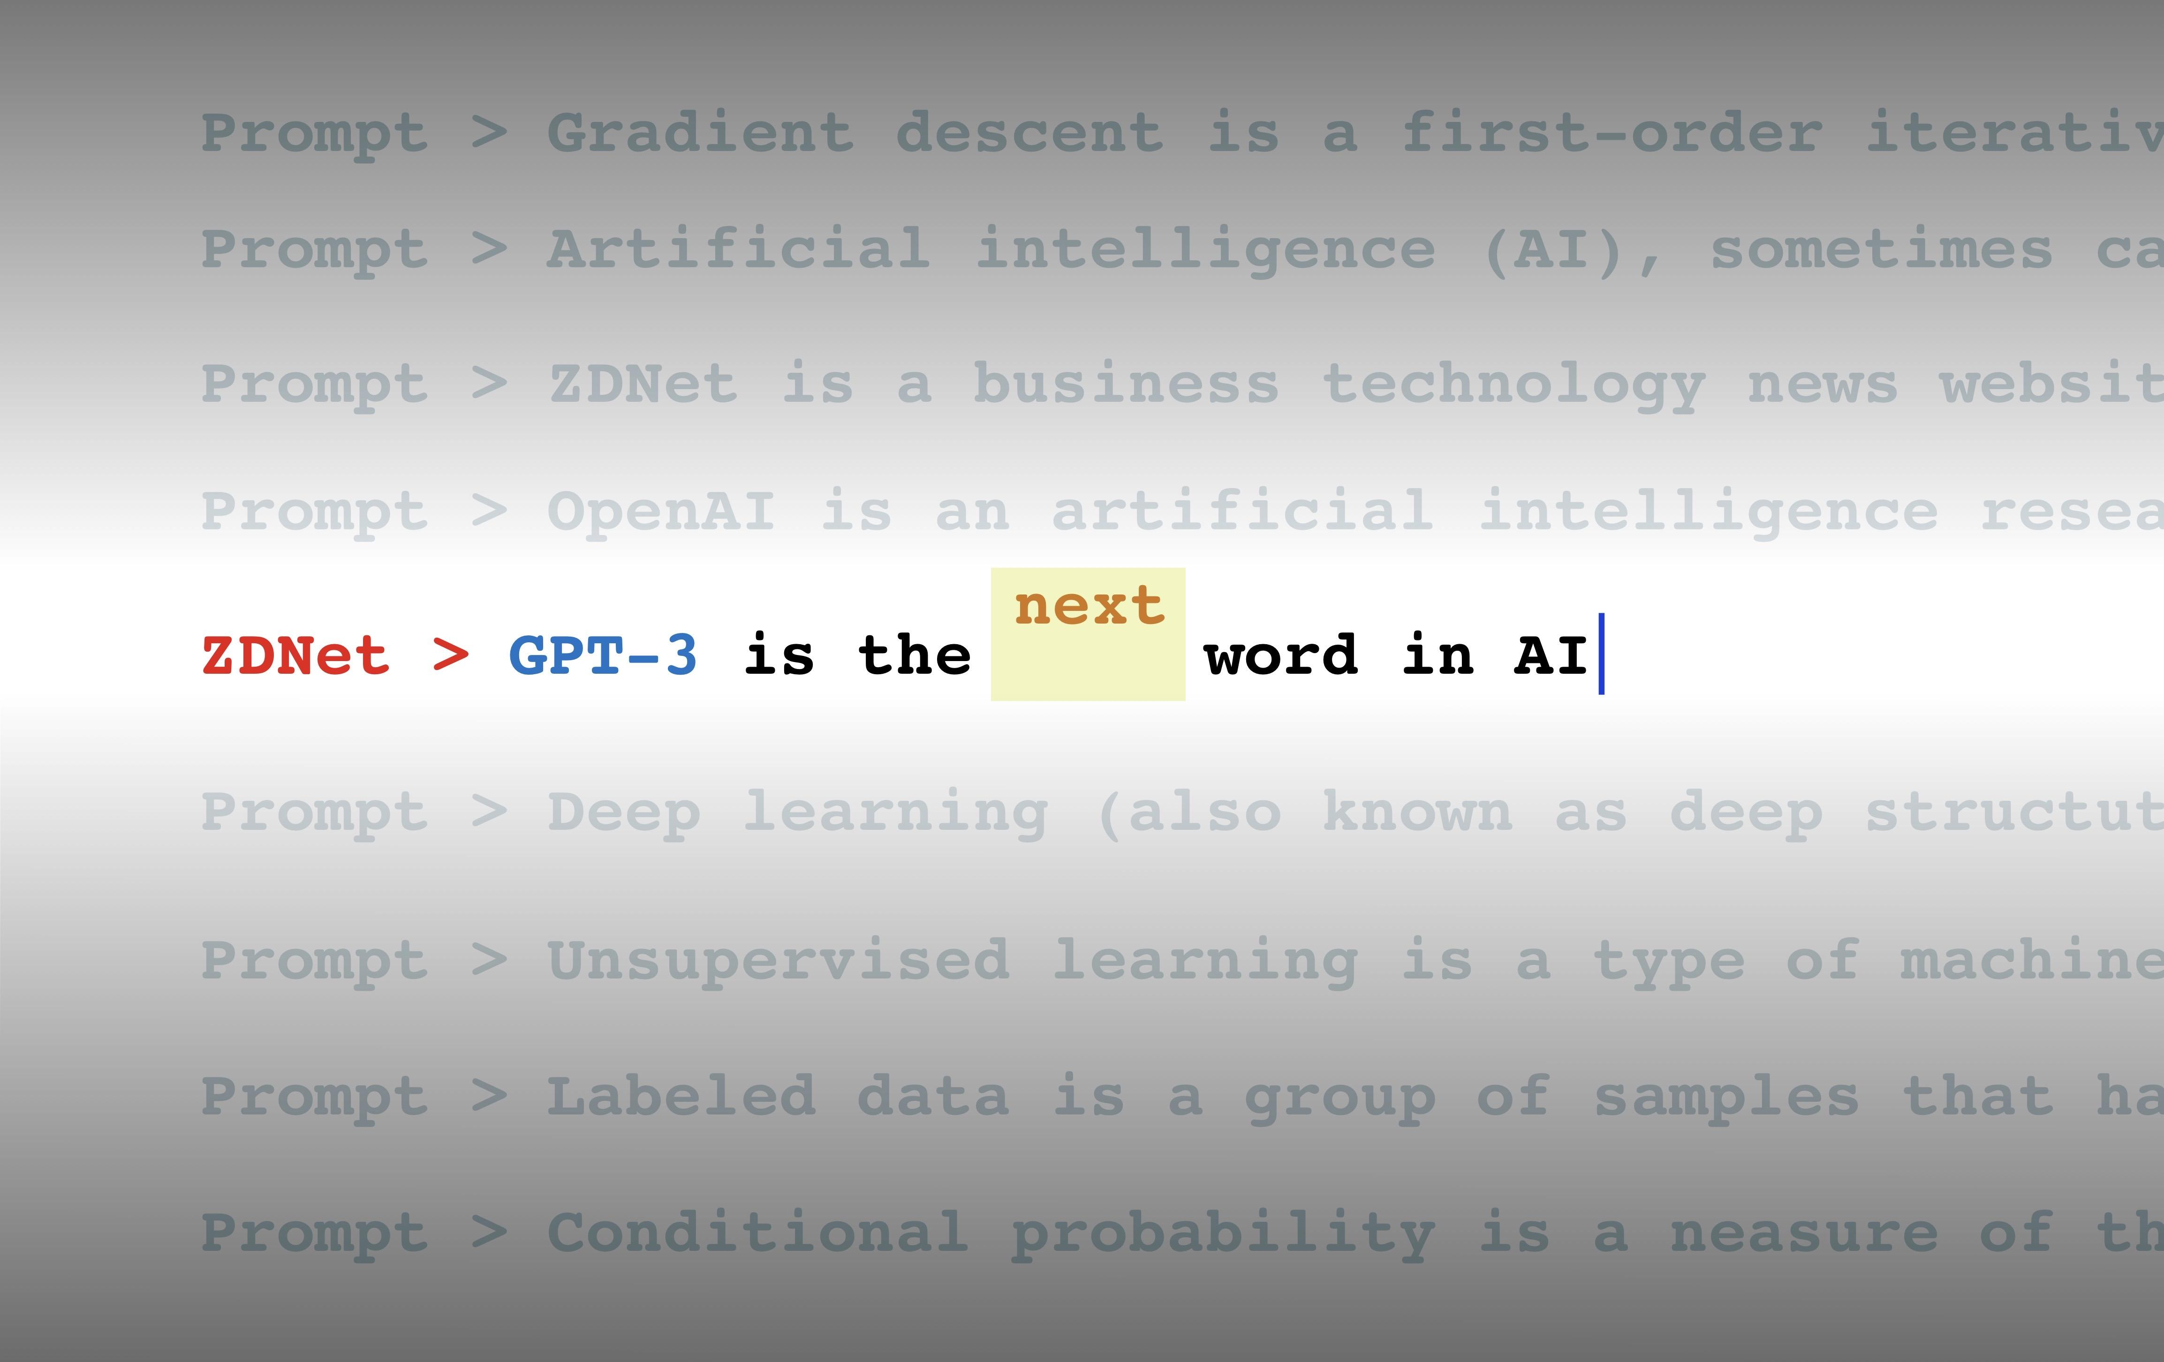
Motivations
Unsupervised Generative Pre-training revolutionized NLP
Flagship systems like GPT-3 (Brown et al., 2020) are now competitive across many zero-shot tasks requiring little/no dataset specific training data.
Pre-training methods of large-scale web text data surpasses that of high-quality human-labeled NLP datasets
Notes:
As has been proved by GPT-3

Slide 4
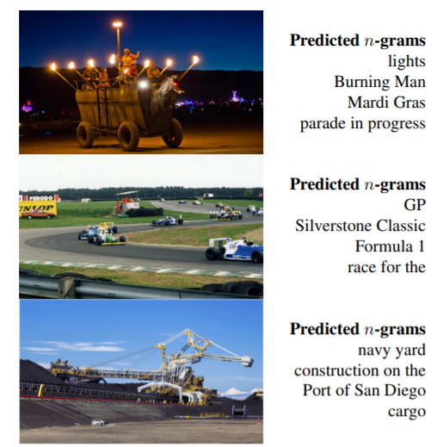
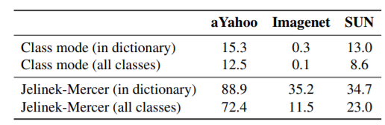
Motivations
Could large-scale web text helps with pre-training in computer vision?
Learning Visual N-Grams From Web Data (Li et al., 2017)
Train a CNN to predict n-grams from images
Matched target classes with n-grams in the dictionary
For a given image, predict n-grams, score each class, and predict the highest-scoring class for that image
Notes:
Could such large-scale web text helps with pre-training in computer vision? There are already some prior works in connecting text and images in this field. The most inspirational work for the CLIP model, is the work by Li et al. In 2017 What the paper basically does is it first train a CNN to predict n-grams from images, then when it applies zero-shot transfer to image classification, it first matched target classes with n-grams in the dictionary .., The author apply the zero-shot transfer to 3 datasets aYahoo, ImageNet and Sun. While it gets acceptable results on aYahoo, it only gets 11.5% accuracy on the ImageNet, and there are still quite a lot room for improvement.

Slide 5
Motivations
Advance in architectures and pre-training approaches in learning visual representations from natural language supervision
Auto-regressive language modeling: VirTex (Desai & Johnson, 2020)
Masked language modeling: ICMLM (Bulent Sariyildiz et al., 2020)
Contrastive Objective (used in CLIP): ConVIRT (Zhang et al., 2020)
Notes:
Also, another source of motivations is that recently we have witnessed great advance in architectures and pre-training approaches in related areas. Auto-regressive language modeling by VirTex (introduced by Linyi), the masked language modeling by ICMLM, and Contrastive Objective by ConVIRT, which is also a method used in CLIP
So that’s basically all the motivations behind this paper. Do you have any questions? Okay, I will continue

Slide 6
Dataset
Scale Difference
WebText (dataset for GPT-2)
40GB data, ~10B word count
MS-COCO
100K
Visual Genome
100K
YFCC100M
100M, only 15M after data-cleaning (similar size as ImageNet)
Notes:
The first contribution of the paper is a large dataset, while they do not make it open source. The author discovered that there is large scale difference in dataset between current NLP work , and language supervised visual pretraining. Basically, GPT-2 is trained on WebText, which has around 10B words in the dataset, while existing language-visual work mainly uses three dataset, MS-COCO, Visual Genome and YFCC100M. MS-COCO and Visual Genome is all of one hundred thousand scale, the YFCC100m contains 100M data, but it is of varying quality and after data cleaning there are only 15M useful data, which is similar in size as the ImageNet.

Slide 7
Dataset
WebImageText (WIT)
10B (image, text pair), similar scale as WebText used in GPT-2
500000 queries, 20000 (image, text) pair for each query
query list: all words occurring >= 100 times in Wikipedia, augmented with common bi-grams as well as the names of all Wikipedia articles above a certain search volume.
Notes:
To take advantage of the almost unlimited web text data and bridge this gap, the author of CLIP created a very large Dataset called WebImageText, which contains 10B image text pair, similar scale as WebText used in GPT-2. The author constructed the dataset by first making a 500000 query list, which contains all words occurring more than 100 times in Wikipedia, …, then they collect approximately 20000 image, text pair for each query, and obtained the final 10B dataset.

Slide 8
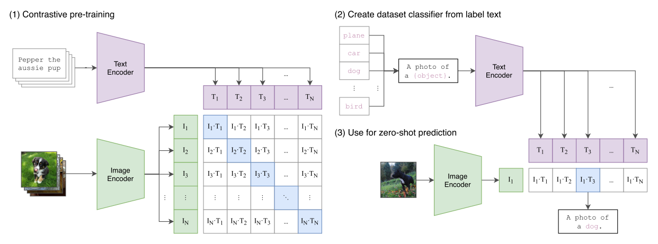
Approach
CLIP (Contrastive Language–Image Pre-training)
Notes:
Having the dataset, let’s talk about the core approach of this paper, CLIP, short for Contrastive Language-Image Pre-training. Actually the methodology is mainly drawn from prior work. It can be mainly divided into 3 parts, (1) Contrastive pre-training, (2) create dataset classifier from label text (3) and use that for zero-shot prediction. And I will talk about them in detail one by one.

Slide 9
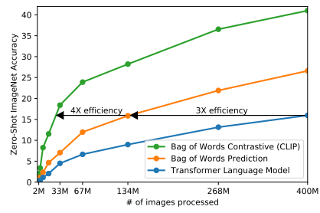
Approach
Contrastive Pre-training
Initially try to trained an image CNN and text transformer jointly to predict the caption of an image (similar to VirTex)
Change objective to predict Bag of Words with 3X efficiency.
Change predictive objective to contrastive objective with 4X efficiency.
Notes:
For the pre-training part, initially they tried to trained an image CNN and transformer jointly to predict the caption of an image, which is similar to the approach used in VirTex. However, they encountered difficulty in scaling and the training is pretty slow, so they switch the objective to predict Bag of words related instead of caption and this speeds up the training process 3 times. To further improve efficiency, they incorporate the idea of Contrastive Learning by changing the objective to determining which text is paired with which image instead of directly predicting the text from images, and this times they observed a further 4 times of efficiency improvement

Slide 10
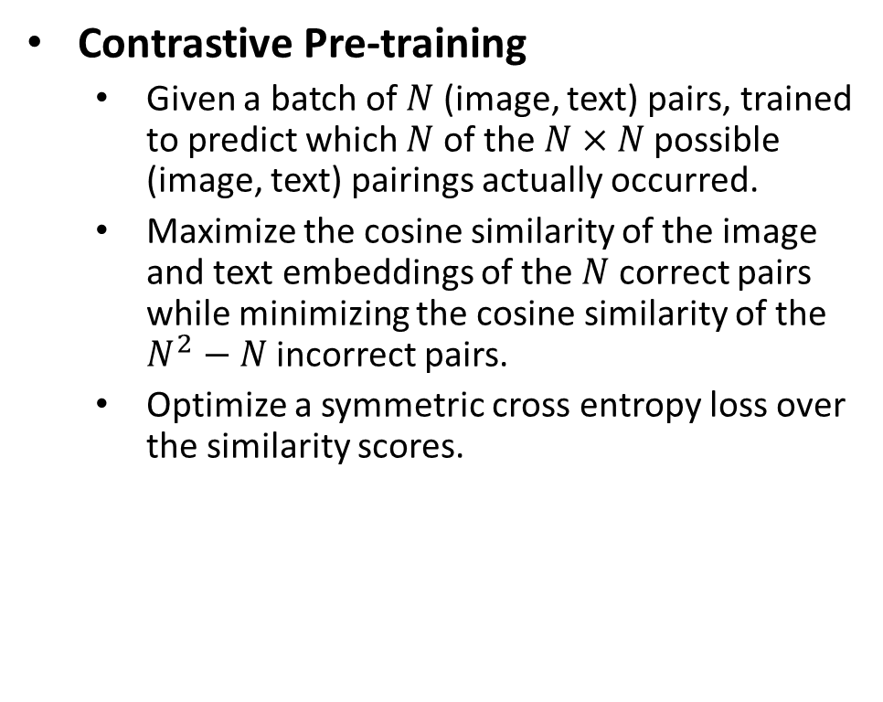
Approach
Contrastive Pre-training
Given a batch of $N$ (image, text) pairs, trained to predict which $N$ of the$N×N$ possible (image, text) pairings actually occurred.
Maximize the cosine similarity of the image and text embeddings of the $N$ correct pairs while minimizing the cosine similarity of the $N^{2}−N$ incorrect pairs.
Optimize a symmetric cross entropy loss over the similarity scores.
Notes:
To provide more detail about the contrastive objective, given a batch …

Slide 11
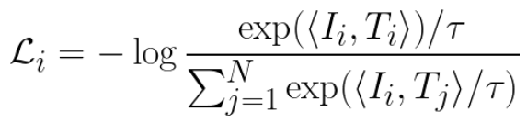
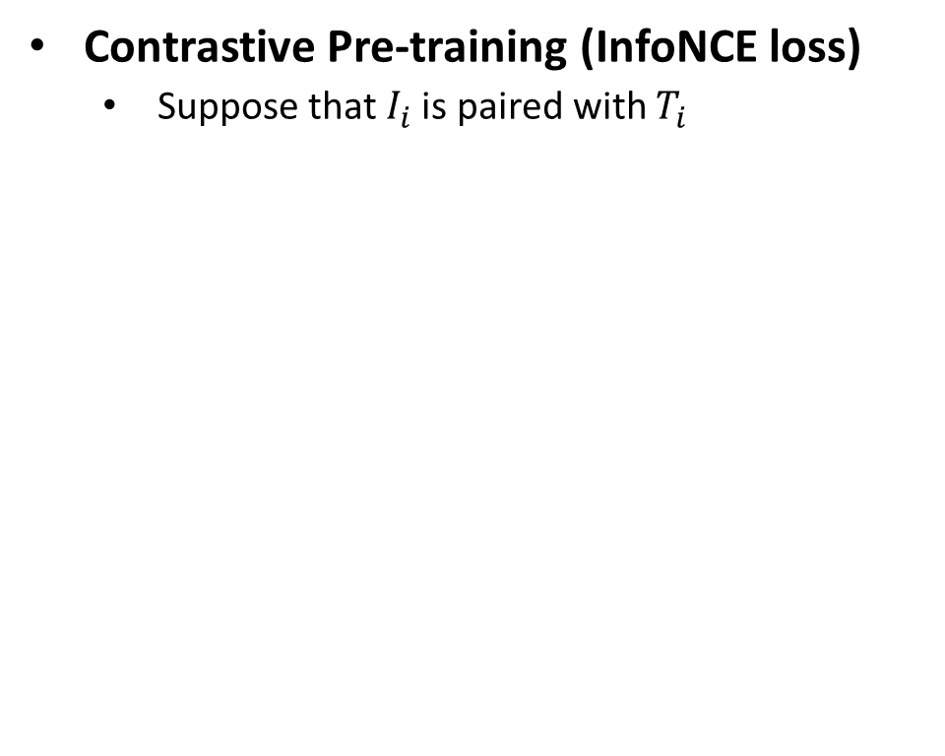
Approach
Contrastive Pre-training (InfoNCE loss)
Suppose that $I_{i}$is paired with $T_{i}$
Notes:
To provide more details, they used the InfoNCE loss, which is commonly used in contrastive learning and has been covered in Monday presentation. Since they do not apply any new modifications I will not talk about them in details then.

Slide 12
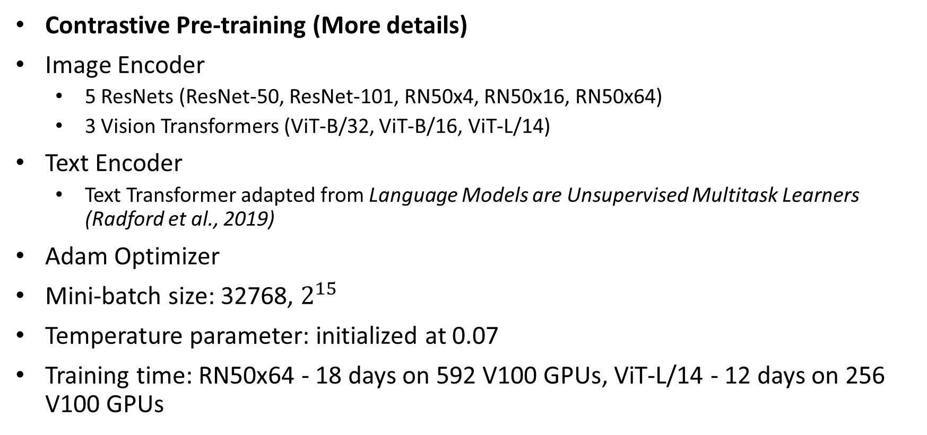
Approach
Contrastive Pre-training (More details)
Image Encoder
5 ResNets (ResNet-50, ResNet-101, RN50x4, RN50x16, RN50x64)
3 Vision Transformers (ViT-B/32, ViT-B/16, ViT-L/14)
Text Encoder
Text Transformer adapted from Language Models are Unsupervised Multitask Learners (Radford et al., 2019)
Adam Optimizer
Mini-batch size: 32768, $2^{15}$
Temperature parameter: initialized at 0.07
Training time: RN50x64 - 18 days on 592 V100 GPUs, ViT-L/14 - 12 days on 256 V100 GPUs
Notes:
Regarding the architecture of the model, they trained 8 image encoders, using 5 different ResNets and 3 different Vision transformers. And they use a text transformer adapted from Radford’s work in 2019. And they uses…, due to the large scale of data, they use a corresponding large mini-btach size. And here are the training times for the 2 largest model.

Slide 13
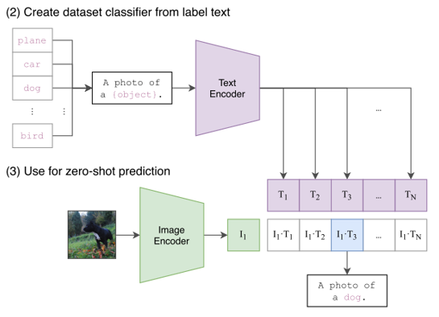
Experiments
Zero-Shot Transfer
(2) All the classes in the dataset for evaluation are arranged in a specific format like “a photo of a {classname}” and fed into the text encoder.
(3) Feed the image into the image encoder, then CLIP performs a similarity searches and predict the best pair.
Notes:
After training, Zero-shot prediction can be performed. What happens here is that in the second step, all the classes in the dataset for evaluation are arranged in a specific format like “a photo of a {classname}’ and that formatted text is fed into the text encoder. Similar to pre-training, once the image is passed to the encoder, CLIP performs a similarity search and predict the best pairs for the given image.
That’s the details of zero-shot implementation. You can see that there are no great innovations in methodology and the only difference is the large-scale dataset data set it get trained on.

Slide 14
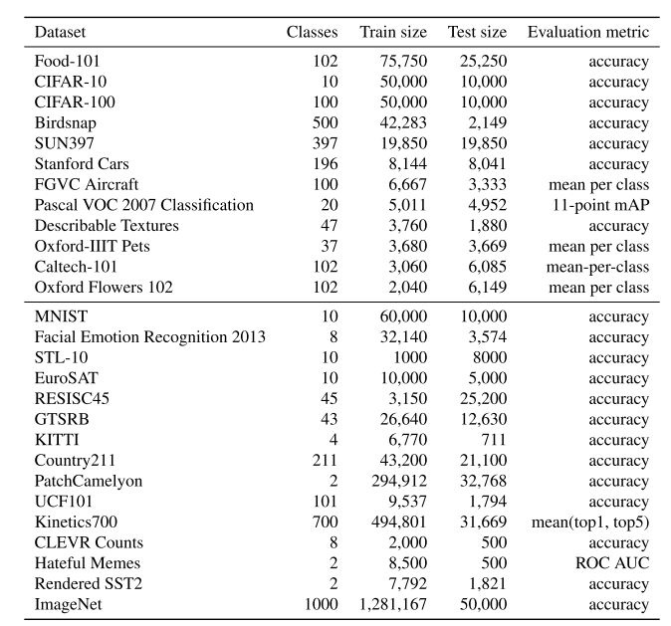
Experiments
Notes:
Then what about the performance? When it comes to evaluation, they evaluate the performance of CLIP across 27 comprehensive datasets listed in the table. Including some canonical datasets like ImageNet, CIFAR and many others.

Slide 15
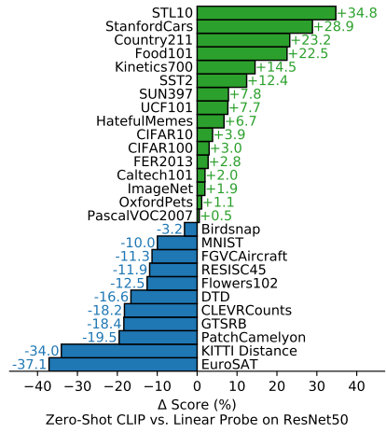
Experiments
Zero-Shot Transfer
Compared with a fully supervised baseline (ResNet50, trained on ImageNet) across 27 datasets.
Outperforms supervised ResNet50 without seeing any of the data in ImageNet
Achieve SOTA on STL10, a dataset designed to encourage efficient learning by providing only a limited number of labeled examples
Notes:
And then they evaluate the zero-shot performance of the CLIP by comparing it with a fully supervised baseline ResNet50 across 27 datasets. The results are shown in the figure and you can see that the zero-shot CLIP even outperforms ResNet-50 on ImageNet without seeing any of human-labeled data in ImageNet. And it achieved SOTA on STL10, which is a dataset designed to encourage efficient learning by providing only a limited number of labeled examples. This is very intuitive since CLIP is 100% data-efficient.

Slide 16
Experiments
Zero-Shot Transfer
Task-Specific Object Detection
Outperforms on StanfordCars and Food101
Underperforms on FGVCAirCraft, Flowers102 and MNIST
Matches on OxfordPets and Birdsnap
Difference comes from varying task-specific supervision in WIT and ImageNet
General Object Detection
Outperforms slightly on CIFAR10,CIFAR100, ImageNet, and PascalVOC2007
Notes:
Some in-depth analysis here, they discovered that for task-specific object detection, CLIP outperforms. They suspect theses differences comes from varying task-specific supervision in WIT and ImageNet, like maybe there are more food (text, image) pairs in WIT than ImageNet while more flowers labeled-data in ImageNet. They analyzed this for MNIST, that through nearest-neighbor retrieval they verified that there are almost no images that resembles MNIST hand-written digits in the WIT dataset.
And they found that CLIP outperforms baseline slightly for all general object detection datasets and they believe this reflect the true object detection capacity of CLIP

Slide 17
Experiments
Zero-Shot Transfer
Outperforms baseline on 2 datasets measuring action recognition in videos.
Intuition: Natural language provide wider supervision for visual concepts involving verbs, compared to the noun-centric object supervision in ImageNet
Notes:
More analysis here, they discovered that CLIP outperforms baseline on 2 datasets measuring action recognition in videos, and they speculate this is due to natural language providing wider supervision for visual concepts involving verbs, compared to the noun-centric object supervision in ImageNet

Slide 18
Experiments
Zero-Shot Transfer
Underperforms on specialized, complex, abstract tasks.
Satellite image classification (EuroSAT and RESISC45)
Tumor detection (PatchCamelyon)
Counting objects in synthetic scenes (CLEVRCounts)
Self-driving related tasks (GTSRB, KITTI Distance)
Intuition: whether zero-shot transfer, as opposed to few-shot or supervised ones, could really performs well on complex tasks without any “prior experience”.
Notes:
For datasets that CLIP notably underperforms the baseline. They find most of them to be specialized complex or abstract tasks.
By contrast, non-expert humans can robustly perform several of these tasks, such as counting, satellite image classification, and traffic sign recognition, suggesting significant room for improvement. Their intuition is that they suspect whether zero-shot transfer could really performs well on complex tasks without any “prior experience”, or exposure to training data, for example like tumor classification or traffic sign recognition.

Slide 19
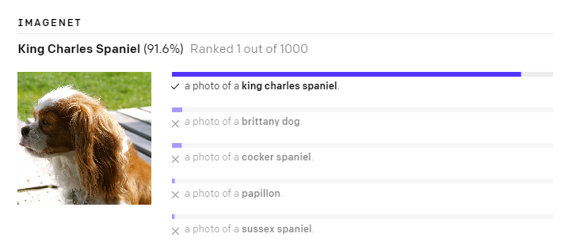
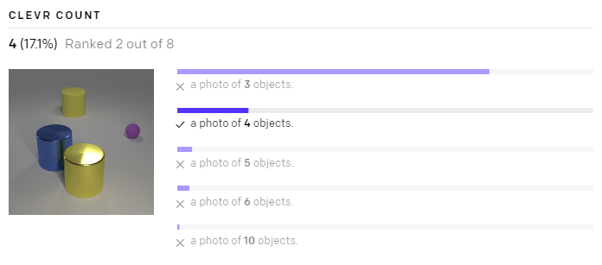
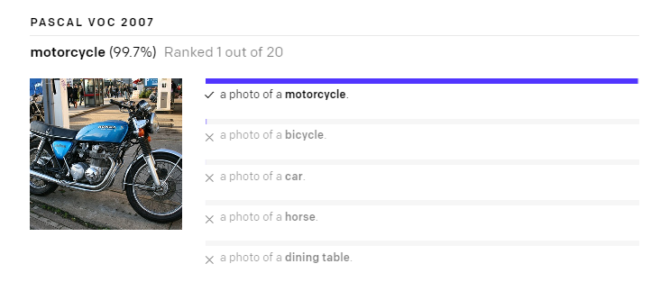
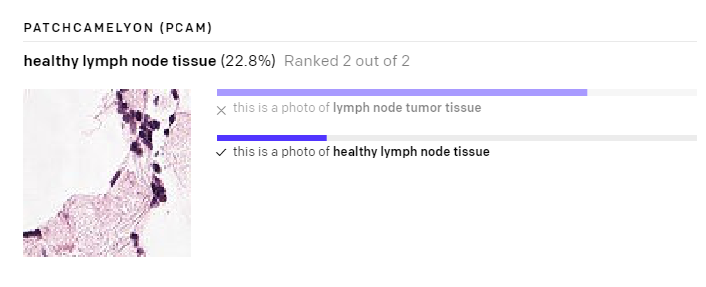
Experiments
Notes:
Here are some of the zero-shot results, as you can see, it performs well on normal classification like dogs and motorcycles while it performs worse on more complex and abstract problems like object counting and tumor detection

Slide 20
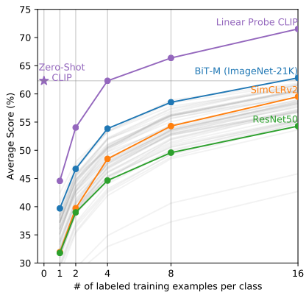
Experiments
Zero-Shot Transfer
Matches the best results of a 16-shot linear classifier across publicly available models (BiT-M)
Zero-shot outperforms one-shot!
Matches the average performance of a 4-shot linear classifier trained on the same feature space
Notes:
Aparts from comparing with supervised model, they also compare CLIP with existing few-shot methods. CLIP matches the best results of a 16-shot linear classifier across publicly available models. One exciting result they get is that they find that the fully unsupervised zero-shot clips even outperforms one-shot CLIP itself. And it .. This provides another aspect of generalization ability of the zero-shot CLIP classifier.

Slide 21
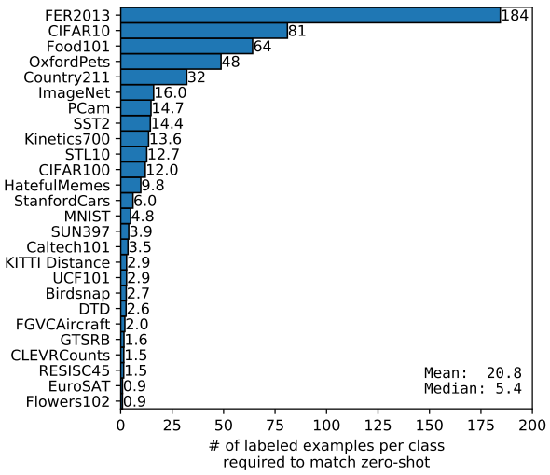
Experiments
Zero-Shot Transfer
Data efficient:
N-shot matches zero-shot
Mean: 20.8
Median: 5.4
ImageNet: 16
Notes:
And they carry out more experiments on data efficiency that they estimate how many labeled examples are needed per class for supervision to match the zero-shot performance of CLIP. … It takes 16 data per class to match the performance of CLIP

Slide 22
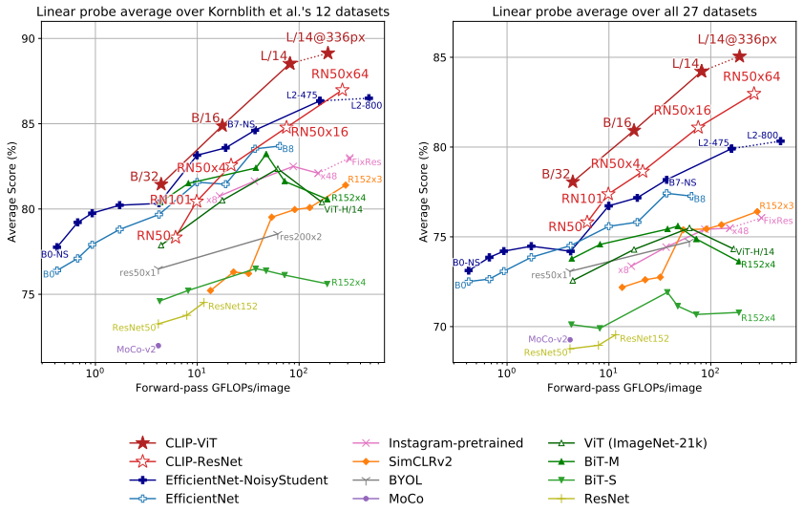
Experiments
Representation Learning - Linear Probing
Vision Transformer are about 3x more compute efficient than ResNets, consistent with the findings of An image is worth 16x16 words: Transformers for image recognition at scale (Dosovitskiy et al., 2020)
Fine-tuned ViT-L/14 at 336x336 px for 1 additional epoch
Evaluated across 27 datasets
Achieved SOTA on 21 datasets
Notes:
Besides zero-shot transferring, they also measure the representation learning capacities of CLIP by linear probing. During evaluation they find that.., Due the compute efficiency, they further fine tune the largest transformer model ViT-L/14 … and they get the best performing CLIP models. And this model achieves an amazing results of SOTA on 21 out of the total 27 datasets.

Slide 23
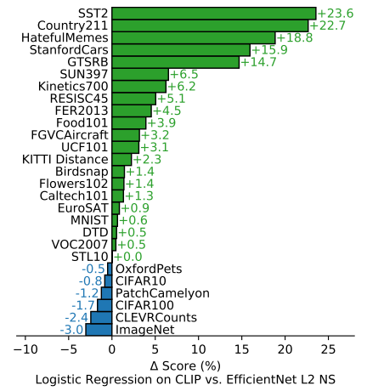
Experiments
Representation Learning - Linear Probing
CLIP outperforms the current best ImageNet model (Noisy Student EfficientNet-L2) on 21 out of 27 datasets.
Outperforms on
OCR (SST2 and HatefulMemes)
Geo-localization and scene recognition (Country211, Sun397)
Activity recognition in videos (Kinetics 700 and UCF101)
Traffic Sign Recognition (GTSRB)
Notes:
And the author also compare it to the current best ImageNet model .. And they carry out some sort of analysis and find that it outperforms significantly on tasks like OCR, Geo-localization, Activity recognition in videos and Traffic Sign Recognition. One thing worth noticing is that, there is only a single label for all traffic and street signs in ImageNet and this may reflect a problem of narrow supervision in ImageNet.
`Although the zero-shot capacity of CLIP is not very good on Traffic Sign Recognition

Slide 24
Experiments
Representation Learning - Linear Probing
Underperforms on ImageNet
Underperforms on low-resolution datasets (CIFAR10, CIFAR100), intuition: lack of scale-based data augmentation
Notes:
And they also analyze tasks than CLIP underperforms. Not surprisingly that it underperforms on ImageNet since the supervised model is trained on ImageNet. And CLIP also … WIT lacks scale-based data augmentation, which seems important for low-resolution data

Slide 25
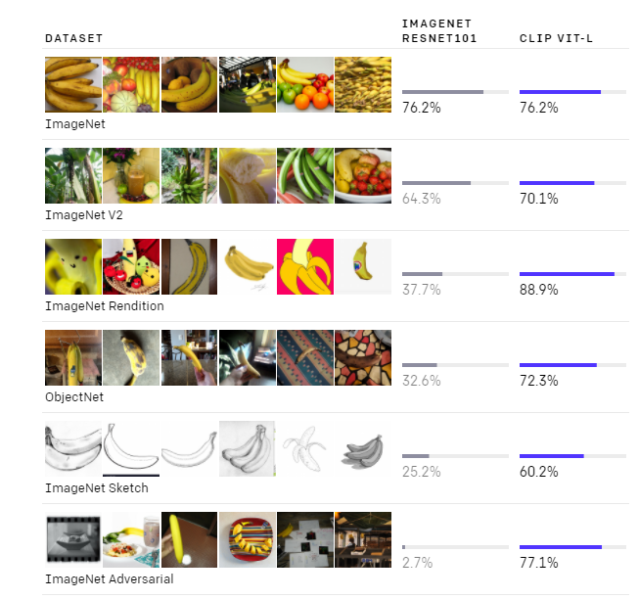
Experiment
Robustness
Compare zero-shot ViT-L/14@336px with supervised ResNet101, which has matched ImageNet performance.
Notes:
Besides performance, the author also evaluate the robustness of CLIP by comparing its performance with a ResNet baseline on several datasets with natural distribution shift from ImageNet. For example the ImageNet Sketch is like converting all images in ImageNet to a grey-scale sketch. And the ImageNet Adversarial applies some adversarial attack noises on images in ImageNet. And you can see that CLIP is very robust to the natural distribution shift.

Slide 26
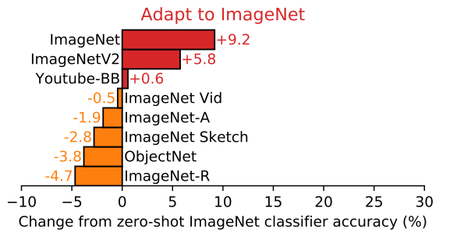
Experiment
Robustness
Adapted CLIP to the ImageNet Distribution via a L2 regularized logistic regression classifier fit to CLIP features on the ImageNet training set.
Accuracy on ImageNet increases by 9.2% while average accuracy across 7 dataset slightly decreases.
Fitting to the ImageNet is not robust to natural distribution shift.
Notes:
To evaluate whether it is the huge amounts of web data that results in the robustness, they tried to adapt the CLIP to the ImageNet distribution via a … That gives some intuition that fitting to the ImageNet itself really provides some overfitting effect and that is not robust to natural distribution shift.

Slide 27
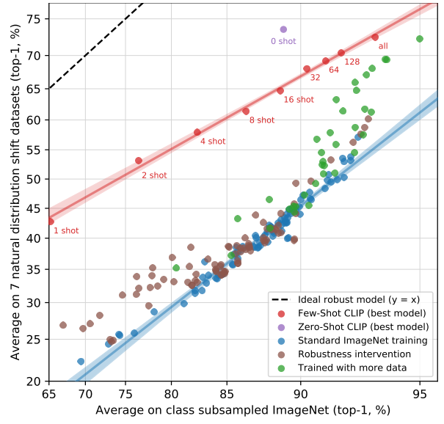
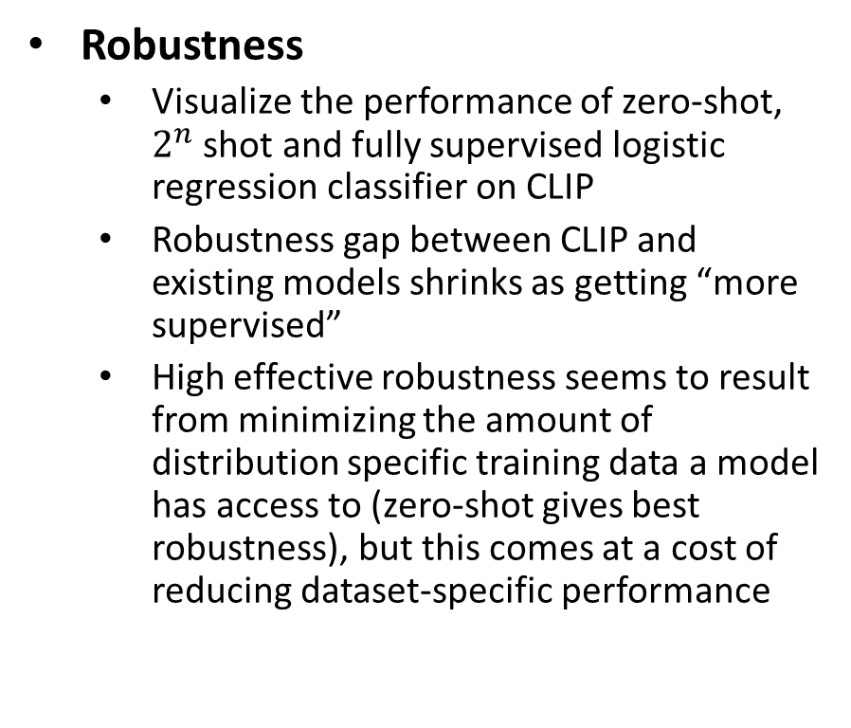
Experiment
Robustness
Visualize the performance of zero-shot, $2^{n}$ shot and fully supervised logistic regression classifier on CLIP
Robustness gap between CLIP and existing models shrinks as getting “more supervised”
High effective robustness seems to result from minimizing the amount of distribution specific training data a model has access to (zero-shot gives best robustness), but this comes at a cost of reducing dataset-specific performance
Notes:
The author also visualize the performance of zero-shot, … on CLIP
The y-axis is the average performance across 7 natural distribution shift dataset
The x-axis in the performance on ImageNet
They speculate that zero-shot is the key to robustness

Slide 28
Summary
Pros:
Abundant web image-text data vs. “Golden” human-labeled data
Generalize well to a series of tasks
Compute Efficient (Bag of words + Contrastive Objective + Vision Transformer)
Cons:
Web data are unfiltered and uncurated, and may exhibit social bias.
Performance still well below supervised SOTA
Struggles on more abstract or complex tasks (e.g. counting objects, predicting tumor)
Poor generalization to images not covered in its pre-training dataset (88% on MNIST, worse than a simple logistic regression)
Notes:
That’s basically all about experiments.
Give a summary of this paper.
Regarding pros, abundant and almost unlimited
which is similar to existing large scale image models web text-image data available
For the Cons,
As you can recall that the best model of the zero-shot CLIP matches that of ResNet101 on ImageNet, which is still way below SOTA. And the author estimate around a 1000x increase in compute is required for zero-shot CLIP to reach overall state-of-the-art performance, which is not achievable with current computing devices.
Also, CLIP
And we observes

Slide 29
Discussion
Should we really consider language-based supervision to be “unsupervised“?
What’s the main advantage of web data compared with human-labeled data? What about disadvantages?
Does language supervised visual pre-training really generalize well or is it mainly the power of data?
What do you think of the future of language supervised visual pre-training?
Notes:
And that’s basically all about

